Slide 1




SALES
REPORT
Presented by: Beltagy Mohamed

Slide 2

Overview
About Us
Goals
Business Problem
Analysis Result
Strategies

Slide 3


About Us
I am a Data Analyst with a foundational knowledge in Machine Learning. My skills focus on leveraging data to uncover insights and drive decision-making.
In this project, I performed data cleaning, data analysis and feature engineering to prepare the dataset and then visualized it on Power BI. In the end, I gained valuable insights that I will explain in this report.

Slide 4


Goals
Objective 01
Objective 02
Find out whether the company is losing or not and know the areas that gain the most in terms of marketing expenses
Calculating revenues according to sales, new expansions, and cities to create a strong marketing plan

Slide 5



Business Problem
Amazon is experiencing a decline in sales due to increased competition, shifting consumer preferences, and operational inefficiencies. Despite its dominant market position, the company faces challenges in maintaining customer loyalty and capturing new market segments. These issues are compounded by rising costs and logistical complexities, which hinder Amazon's ability to adapt swiftly to changing market dynamics. Addressing these challenges requires innovative strategies to revitalize sales growth and ensure sustained competitiveness in the e-commerce landscape.

Slide 6
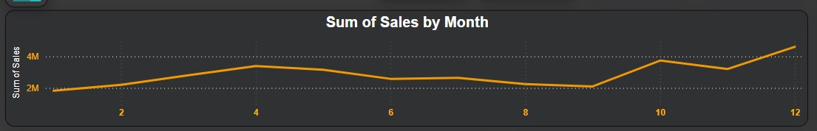

How has sales performance varied over different months?
From here we conclude that this increase in December is due to discounts and holidays, while in January it may be due to setting financial plans and the new year and anticipating economic conditions.
12
01
Best Sales
Less sales

Slide 7
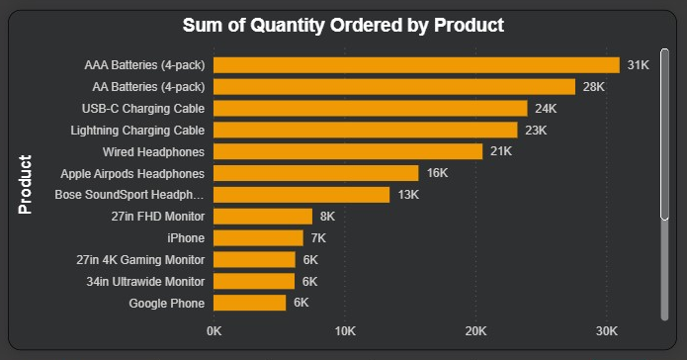
Is there a specific pattern based on the subcategory?
From this figure, we conclude that the best selling products are phone accessories

Slide 8
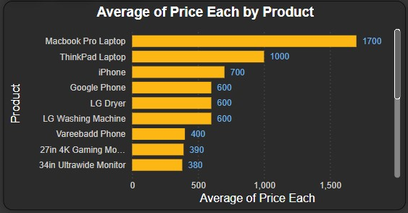
What is the average price for each product?
From this figure, we conclude that the highest-selling products are the cheapest in price, and this does not mean the opposite. For example, the MacBook Pro laptop is the highest-selling, yet it is not the lowest-selling.

Slide 9
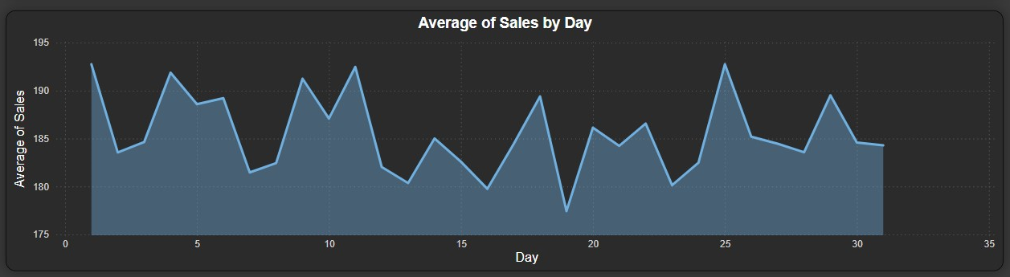
What is the relationship between sales and days?
From this figure, we conclude that the days with the least sales are in the middle of the month and the highest selling days are at the beginning of the month, and this may be related to salaries.

Slide 10
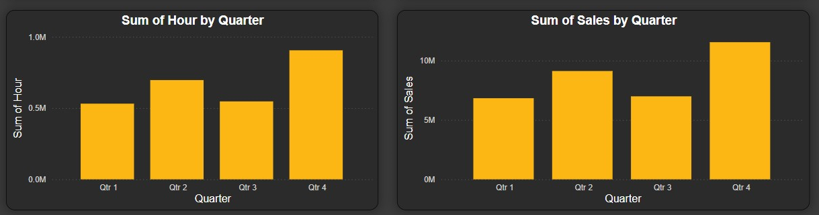
What is the relationship between sales and hours per quarter?
From this figure, we conclude that as the number of hours increases, sales increase.

Slide 11




Strategies
First Step
Increase inventory and increase marketing before November
Second Step
Increase the number of hours because it is directly proportional to sales
Third Step
Find out why the number of hours decreases in the third quarter of the year

Slide 12






THANK YOU
For watching this presentation
Beltagy Mohamed
+201020414643
biltaji.mohamed.com
@beltajy
beltagy-/

